Slide 1
NBA Award Prediction
Group 8 - William Mayes, Hannah Kim

Slide 2
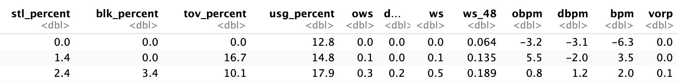
Dataset
CSV files
Player Award Shares - Defensive Player of the year (DPOY), Most Improved Player, Most valuable player, Rookie of the year, Sixth Man of the Year
Advanced – Stats of each player
Team Abbrev - Playoff
ws
Test data – 2023, Training data – 1983 ~ 2022
Notes:
First, we are going to introduce our data. We use these three datasets that we thought it’s important for our prediction. In this project, we want to see if our model can predict the winner among the candidates, and this ‘player award shares’ gives us the information about the award and winner data. There are different kinds of awards in NBA, however, we only focused on the defensive player of the year in this project. The advanced data gives us the statistic of each player which we are going to use all of them as our predictors. For Team abbreviation, we use this it for getting playoff data which we also used as our predictor. After merging these data, we split the data into test and training data by season. Since the result of the 2023 award is the latest result, we use them as our test data and use all the previous season as training data which starts from 1983 to 2022.

Slide 3
Models to Predict the Defensive player of the year
Ridge regression
Lasso regression
Random Forest
Classification tree
Linear regression
Logistic regression
Support vector machine
Notes:
These are the models that we used to predict the winner of the defensive player of the year. We tried to use different models here, from simple models to more complicated model to compare them. I am going to share the results of the first four models. And William is going to continue sharing the results from linear regression model.

Slide 4
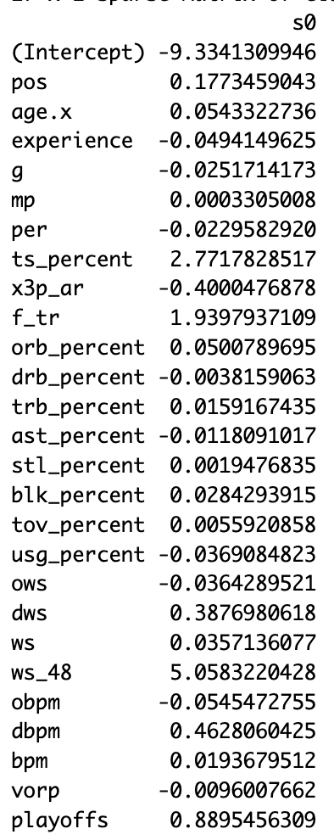
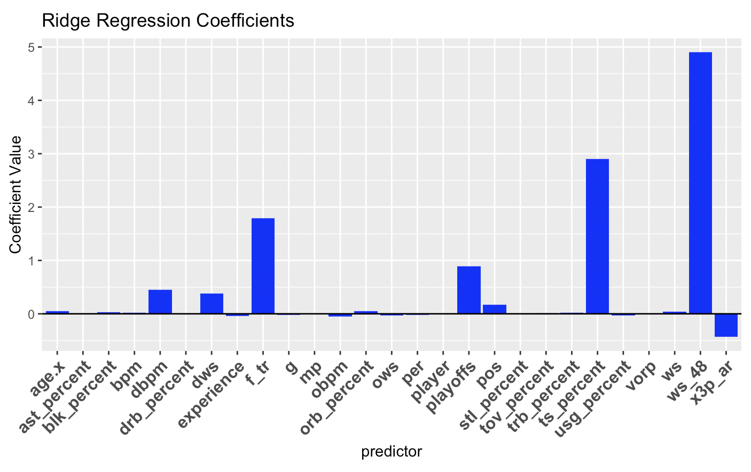






Ridge Regression
Coefficients
*dbpm - defensive box plus/minus
*dws - defensive win shares
*f_tr - free throw rate
*ts_percent - total shot percentage
*ws_48 - win shares per 48 minutes
Notes:
These are the coefficients of predictors from Ridge regression model. Since it is hard to read all the numeric values, the coefficients are also plotted on the right side. In this plot, we can see some of the predictors are visibly correlated with predicting the winner than other predictors.

Slide 5
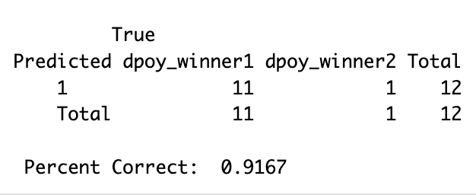
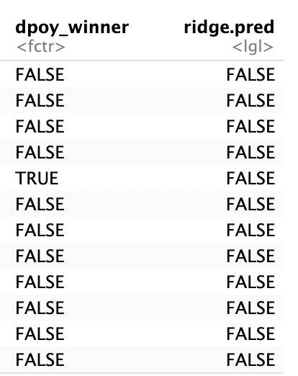
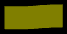
Ridge Regression
Confusion Matrix with Accuracy
Prediction in True/False
False
True
False
Notes:
This is the confusion matrix and it is showing that the model predicts 11 players correctly but 1 player wrong, which we get our accuracy pretty high, however, what this actually means is that the model is predicting none of the player will be the winner. So, on the right side, dpoy winner is showing the actual 2023 results, which among 12 candidates, we should have 1 winner. However, we can see that the ridge regression model predicted all player as False.

Slide 6
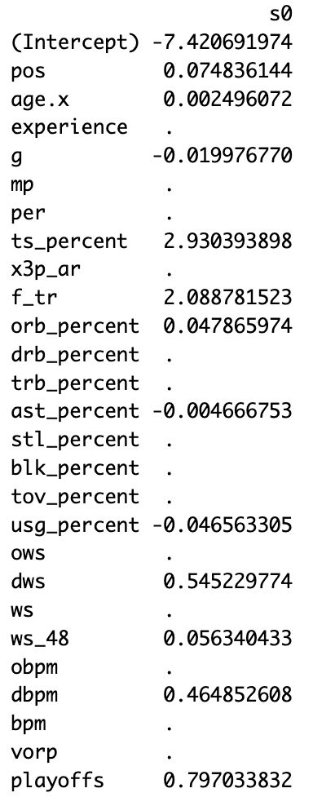
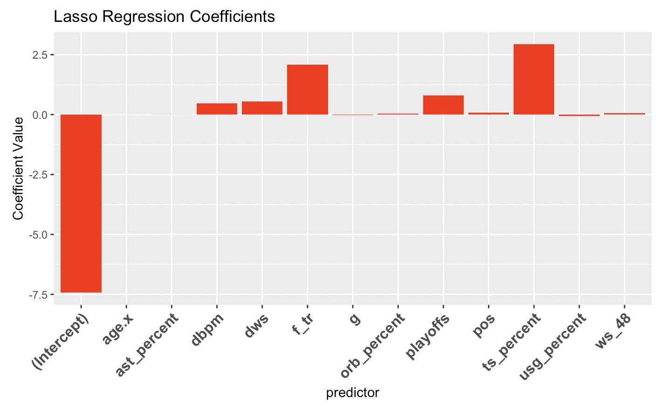






Lasso Regression
Coefficients
*dbpm - defensive box plus/minus
*dws - defensive win shares
*f_tr - free throw rate
*ts_percent - total shot percentage
*ws_48 - win shares per 48 minutes
Notes:
Next, these are the coefficients of the predictors from LASSO regression model. Same as before, the coefficients are plotted on the right side. Here, we can see some of the predictors are eliminated by the model, however, the predictors that are highly correlated to the outcome variable are similar to the ridge regression model except for ws_48.

Slide 7
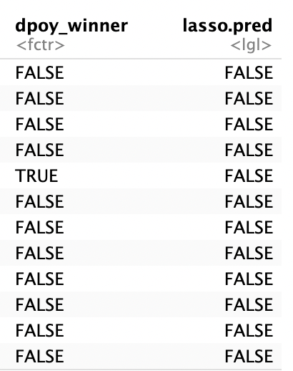
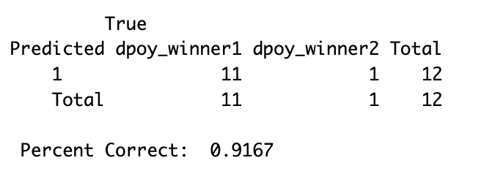

Lasso Regression
Confusion Matrix with Accuracy
Actual Prediction in True/False
False
True
False
Notes:
This is the confusion matrix for Lasso, however, it is same as the ridge regression model. It is predicting all the players as not getting award. So there should be one winner but this model is predicting none of them as winner.

Slide 8
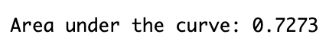
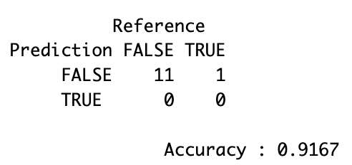
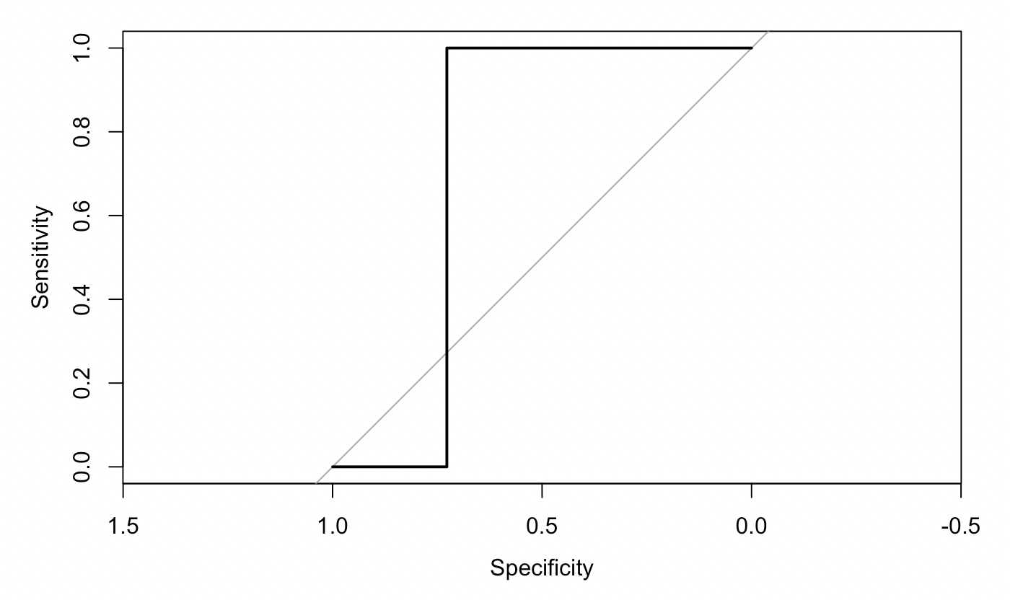
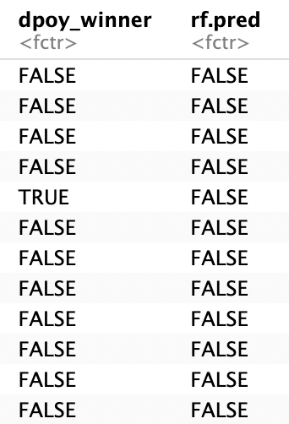
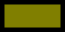
Random Forest
Confusion Matrix with Accuracy
ROC Curve
Actual Prediction in True/False
Notes:
Next is random forest, and this is the roc curve which does not look like other roc curves, but since our prediction is in True or False value, not numeric, it makes sense here. For the confusion matrix, this is literally same with ridge and lasso as predicting all the player as a non-winner.

Slide 9
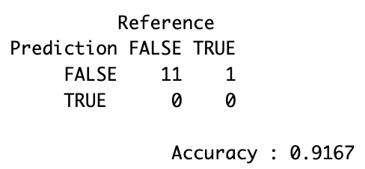
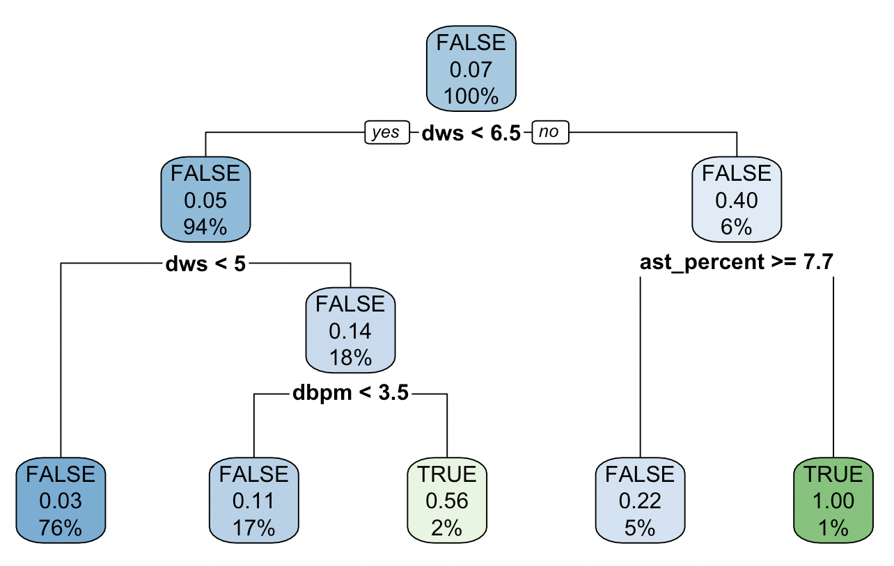
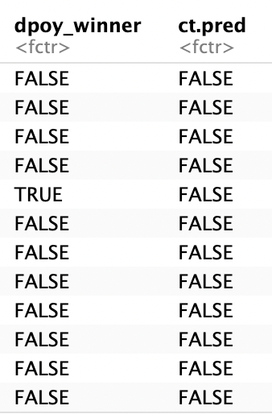

Decision Tree
Confusion Matrix with Accuracy
Actual Prediction in True/False
*dbpm - defensive box plus/minus
*dws - defensive win shares
*ast_percent - assist percentage
Notes:
Last model that I am going to introduce is decision tree. This plot is showing the important features that are used for classifying observations. Here, the variables dws and dbpm and ast_percent are used as the most important variables when training. Same as all the before models, it is not predicting the winner correctly, however, still, we can also say that all these models are predicting players those didn’t get awards correct.

Slide 10
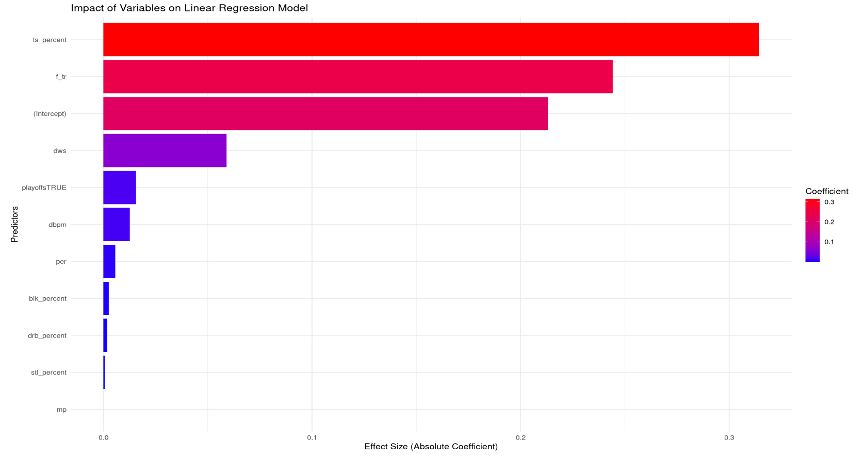
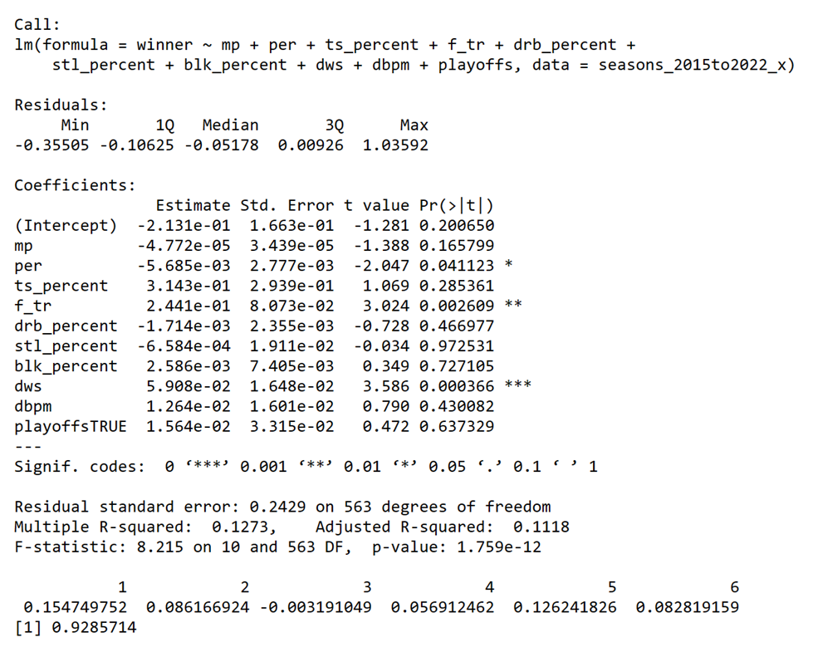
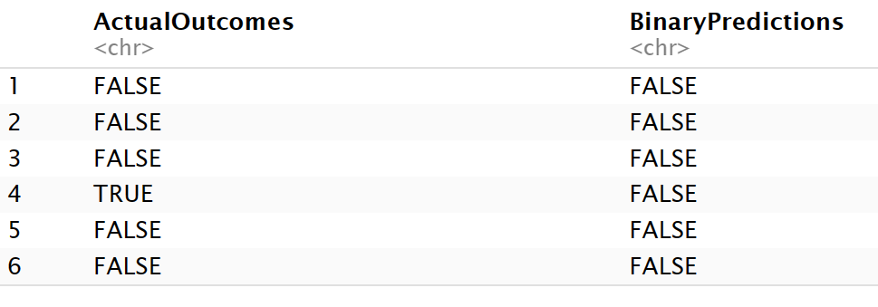


Linear Regression
Accuracy
.9285
Actual Prediction in True/False

Slide 11
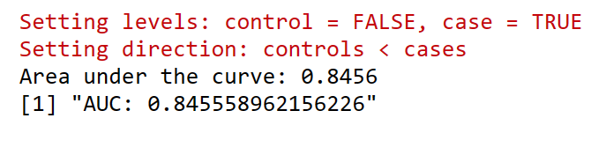
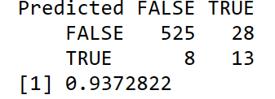
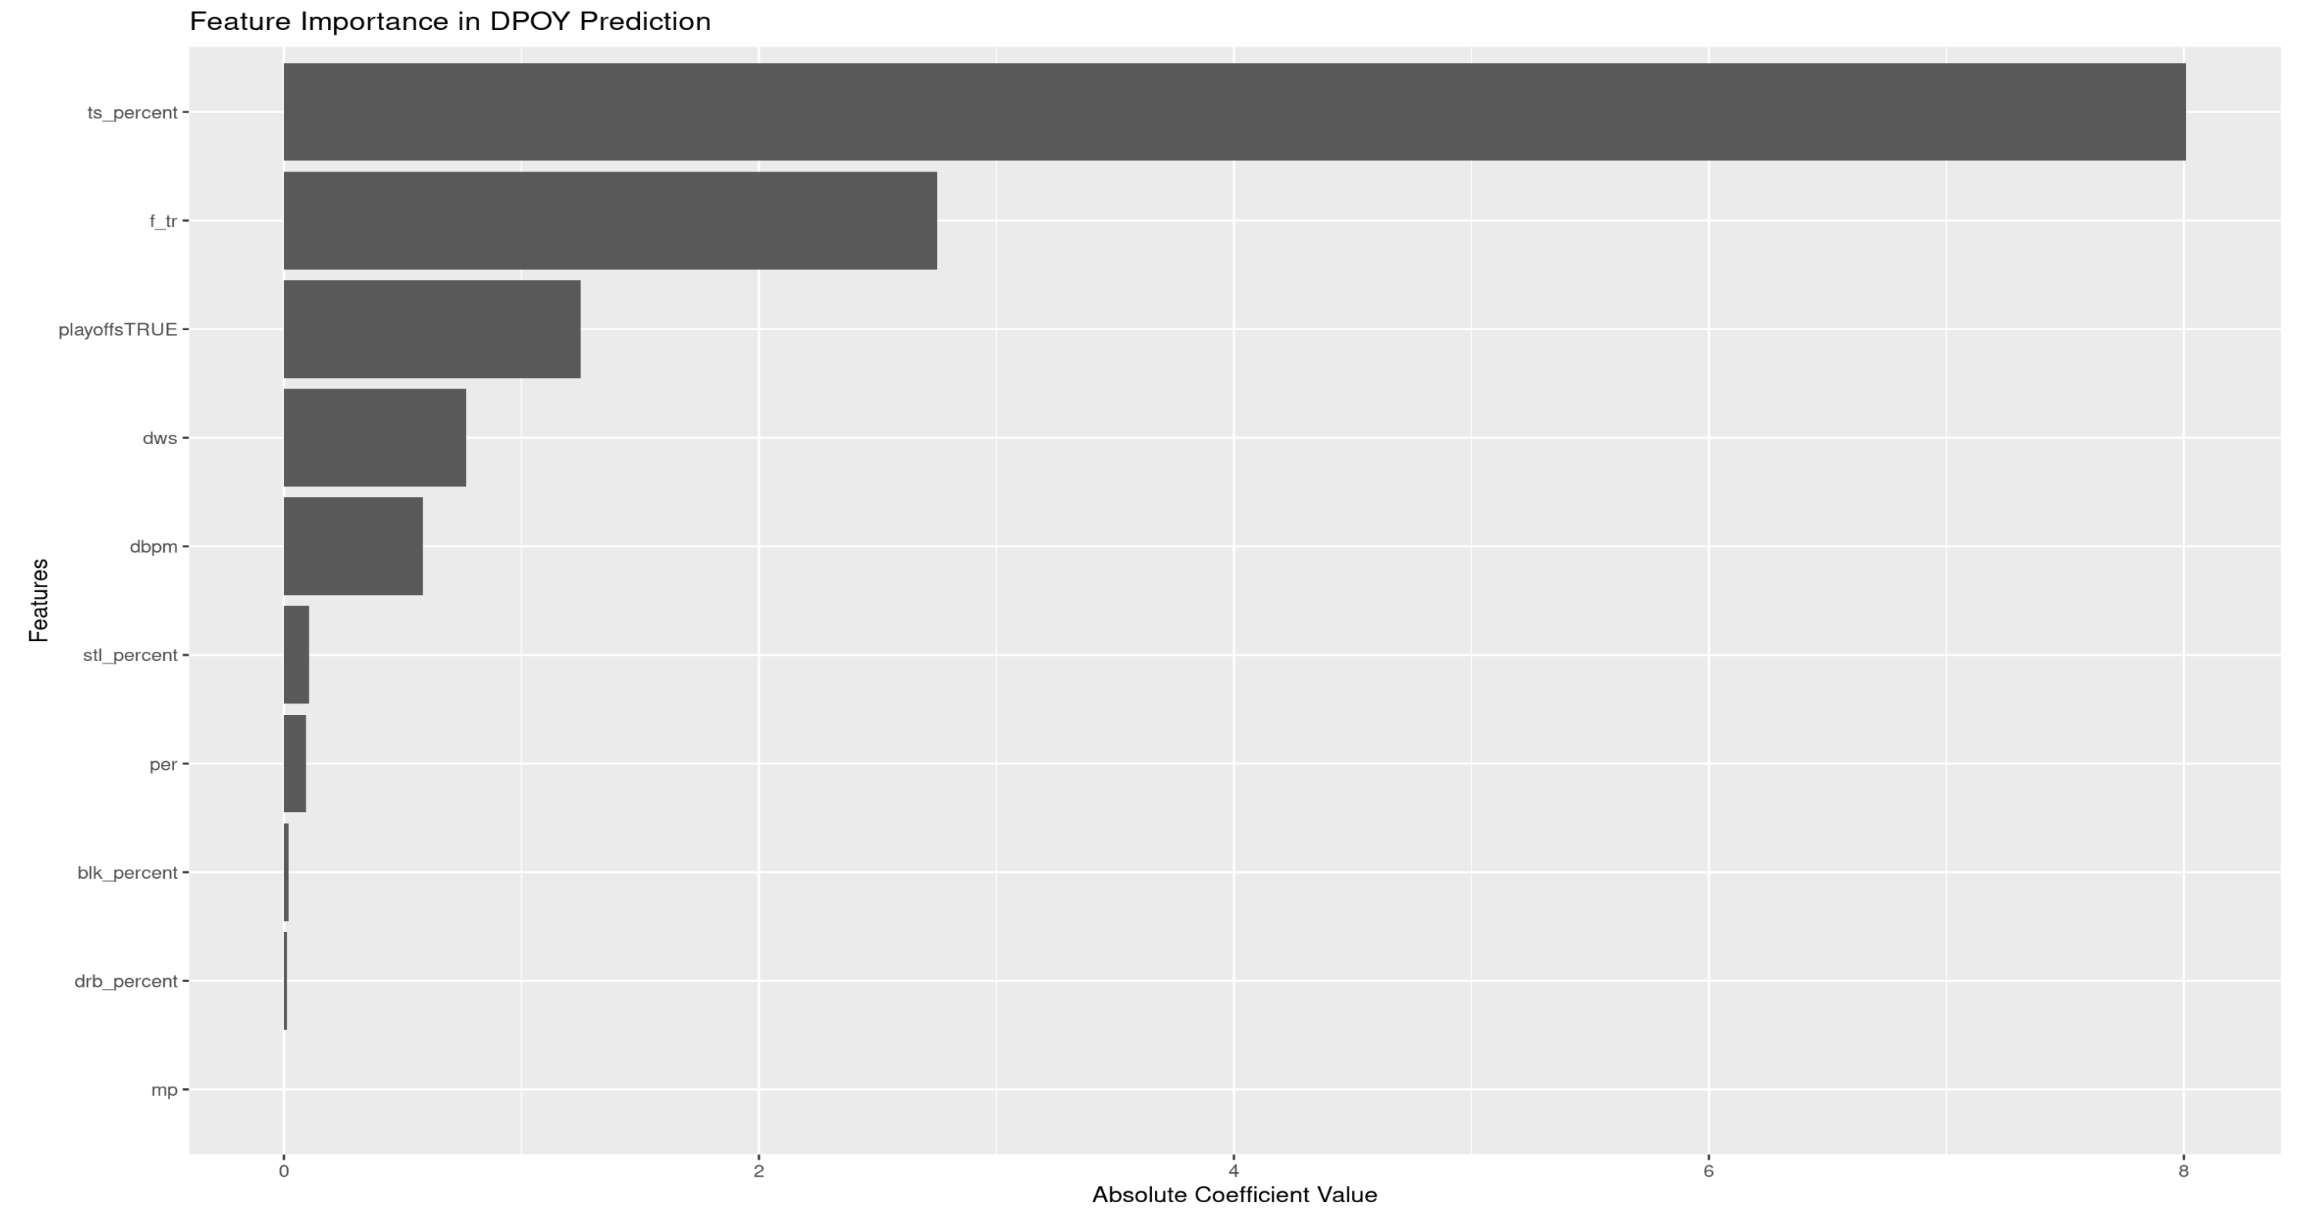
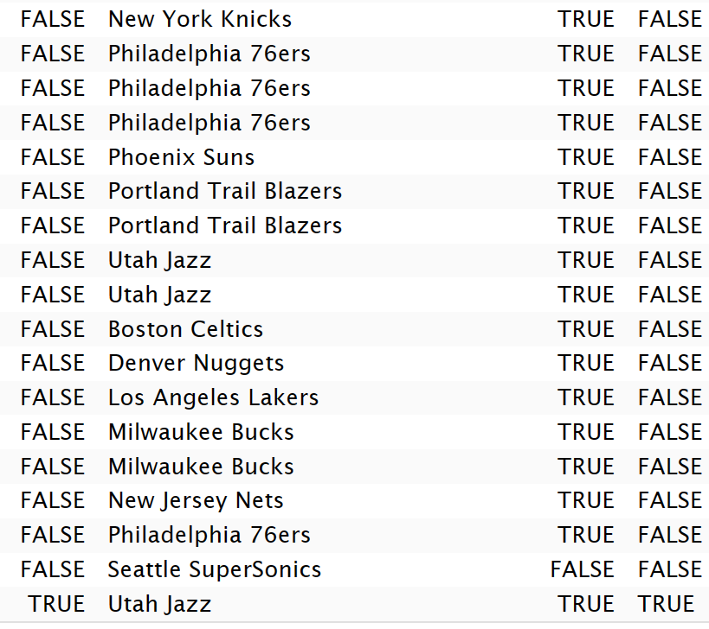


Logistic Regression
Confusion Matrix with Accuracy
Prediction in True/False
Winner
DpoyPred

Slide 12
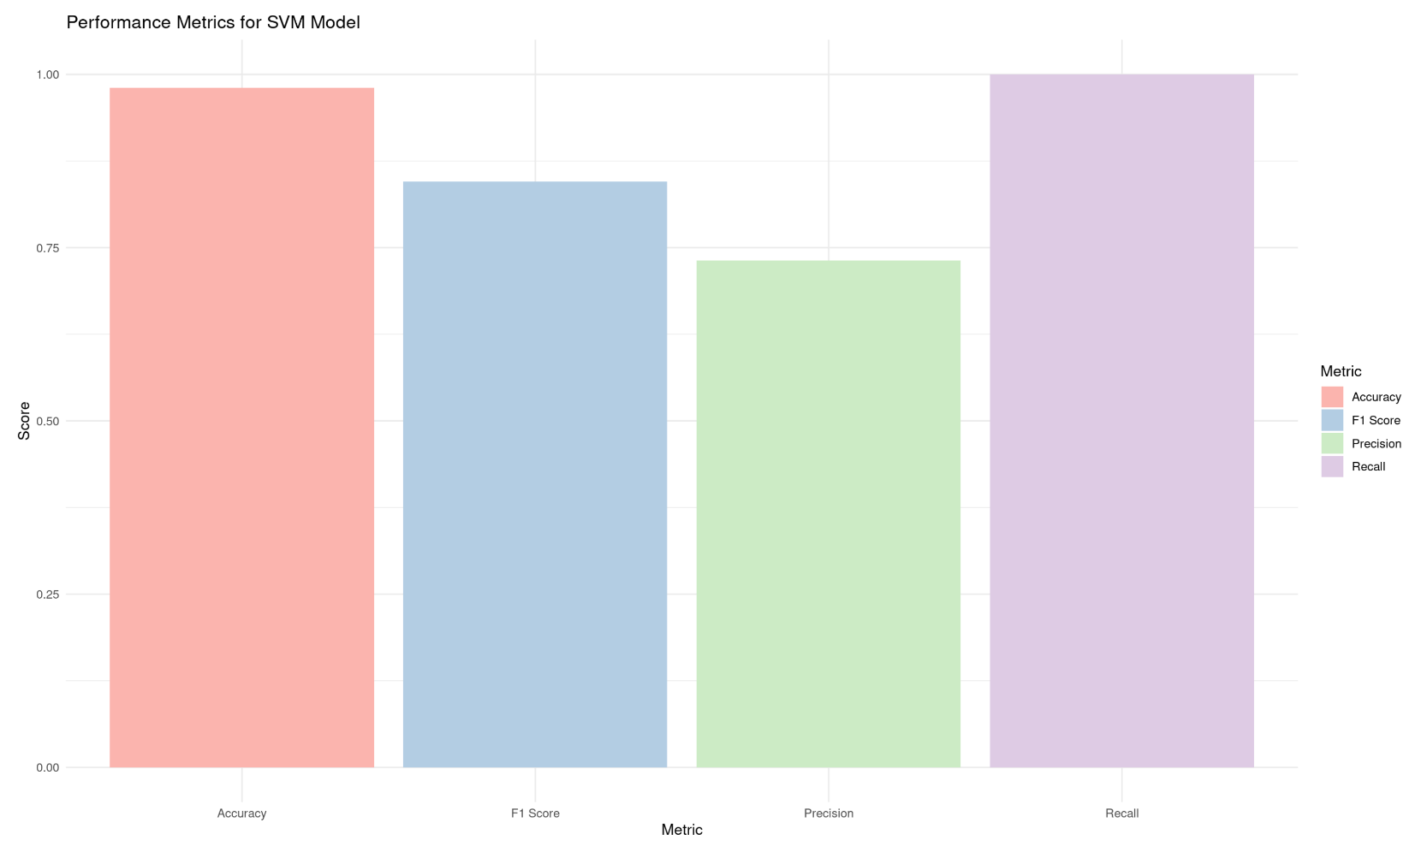
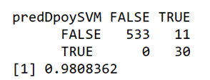
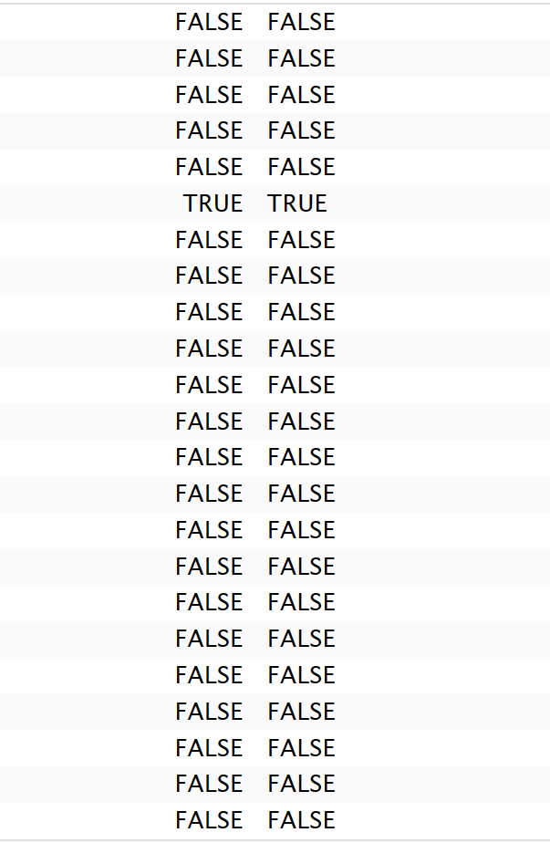


Support Vector Machine
Confusion Matrix with Accuracy
Prediction in True/False
Actual Predicted

Slide 13

Conclusion
Best model
Important predictors
Final thoughts

